Slide 1
Here’s a problem
Working from Monday to Friday can be very exhausting and draining, you get excited when it’s Friday, because the weekend is near, and then the thoughts of the unwashed cloths, licking sinks, dusty apartment, the carpenter that promised to come fix the roof two weeks ago still hasn’t responded. All of it comes to mind and you just want it all to disappear. Now there’s a change your plans. No more resting!, nor flexing with friends! because you want to get them done.
On the other hand, you have a skill, but there’s no formation on ground for you to earn a living, you’re a shop owner with just little customer base, you’d love to earn extra cash during the weekends with your acquired skill to make extra cash for the family.

Slide 2
…and more problems
Even when we manage to find vendors around that can offer the services we need, there is the problem of TRUST.
Are they experts in their respective field?
What is their level of professionalism?
Do they have a walk-in shop?
Who holds them accountable in the case of poor services rendered?
Would I be able to afford it?
How fast can they get here?

Slide 3
Now, picture this!
A solution that takes away the struggle to find these Artisans, just at your fingertips.
A virtual shop, where you can make orders for any of these services you need, just by a search and click. A place where you can also get more jobs opportunity as an artisan/service provider.
A platform where a buffet of professionally registered Artisans near you can be found, from the comfort of your homes…

Slide 4
Who are our target audience?
People in need of service providers.
People who are ready to utilize their acquired skills.

Slide 5
A cross-section of what our target audience has to say about this idea
I get really exhausted during the week due to my type of job, having a platform that assist with weekend chores would be amazing– Lilian, Ipaja
Such a brilliant idea. Hopefully, subscription is not so expensive – Vincent, Ikeja
I own a laundry house and knowing I’d get more jobs at my comfort zone with just being ready to work and on my phone, wow! That would be awesome, wouldn’t mind paying a lot for that – Joe, Egbeda
Lovely one. I will surely download the App – Joel, Ishaga
This is a solution to so many problems – Andrew, Abuja

Slide 6

THE BIRTH OF

Slide 7
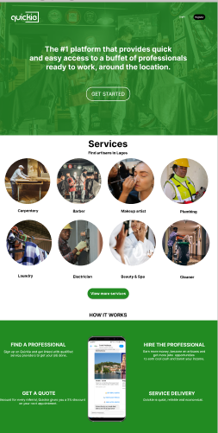
A peek into QUICKIE

Slide 8
HOW TO REGISTER
Click on the link/ Download the quickie app
Click on GET STARTED
Input your correct details and you’re in……. Yes, it’s that easy and simple!
As a client in need of services, click on the MAKE A REQUEST and turn on location…This directs you to a list of service providers available to work in your environment.
To validate your request, you will be requested to create/fund a wallet and make payment. This is an easy and seamless process.
To interface as an ARTISAN, just click on the “Switch To An Artisan” prompt, input the necessary registration details and you are good to go!

Slide 9

Why the Quickie App?
Quickie saves you from a lot of artisan related issues and worries.
Quickie ensures that all service providers are properly and thoroughly observed, to make certain of good job disposal.
Quickie monitors all jobs from the beginning to the end to ensure they are well attended to and in time, and mainly to your requirement.
Quickie provides you with a variety of service provider around your location.
All prices for all available services are listed on the app.
The company only collects 20% as a service charge for every successful job.

Slide 10
This idea would assist in bridging the unemployment gap by assisting people utilize their skills without needing to get any formation on ground or market for their services. One of the major reason of this product in Nigeria, is to help the large number of skilled people in the country make extra cash, and to also provide professional services to clients at their utmost convenience through the app. Quickie aims to reduce unemployment and also assist people earn more cash even if they are employed, I can assure you that more than an average number of people has a skill or the other. You don’t have to bother too much about getting a market to make money, we would help in marketing your skills and direct more customers to you. QUICKIE is quick, accountable, dependable and congenial. THANK YOU!!!

